Slide 1
Windows Azure Overview
Name
Title
Organization

Slide 2
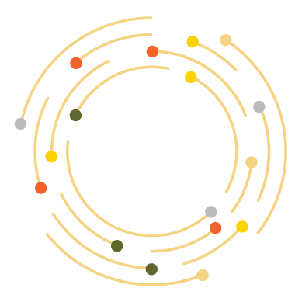

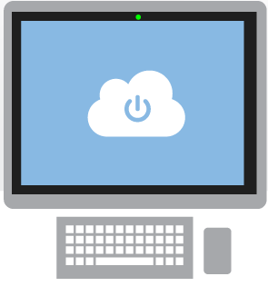
What is the cloud?
An approach to computing that’s about internet scale and connecting to a variety of devices and endpoints
Notes:
Speaking Points:
There are numerous terms and definitions floating around in the industry for “the cloud”, “cloud computing”, “cloud services”, etc.
Microsoft thinks of the cloud as simply an approach to computing that enables applications to be delivered at scale for a variety of workloads and client devices.
The cloud can help deliver IT as a standardized service…freeing you up to focus on your business

Slide 3



Cloud Computing
IaaS
PaaS
SaaS
Infrastructure-as-a-Service
Platform-as-a-Service
Software-as-a-Service
host
build
consume
Notes:
Slide Objectives:
Explain the three established industry terms for cloud services
Speaker Notes:
There is a lot of talk in the industry about different terms like Platform as a Service, Infrastructure as a Service, and Software as a Service.
Since PDC08 when we first announced the Windows Azure our focus has been on delivering a platform as a service offering where you can build applications. Where the platform abstracts you from the complexities of building and running applications.
We fundamentally believe that the future path forward for development is by providing a platform. In fact, as you’ll see in a few minutes, we believe that there are a number of new capabilities that should be delivered as services to the platform.
Notes:
There is a lot of confusion in the industry when it comes to the cloud.
It’s important that you understand both what is happening in the industry and how we think about the cloud.
This is the most commonly used taxonomy for differentiating between types of cloud services.
The industry has defined three categories of services:
IaaS – a set of infrastructure level capabilities such as an operating system, network connectivity, etc. that are delivered as pay for use services and can be used to host applications.
PaaS – higher level sets of functionality that are delivered as consumable services for developers who are building applications. PaaS is about abstracting developers from the underlying infrastructure to enable applications to quickly be composed.
SaaS – applications that are delivered using a service delivery model where organizations can simply consume and use the application. Typically an organization would pay for the use of the application or the application could be monetized through ad revenue.
It is important to note that these 3 types of services may exist independently of one another or combined with one another.

Slide 4

Global Footprint
Notes:
Speaking Points:
Windows Azure itself is deployed around the world
With Windows Azure, we have a concept of regions, which is where you choose to place your code and run.
In each of the regions, we have a Microsoft datacenter.
These datacenters are massive facilities that host 10s or in some cases hundreds of thousands of servers
We have currently four regions in North America, two regions in Europe, and two in Aisa
As you can see on this slide we also have a number of CDN edge points, which we can use to cache your content and deliver it even faster for customers. %
What you’re going to see in the next couple months and years is that we will rapidly expand our datacenter footprint around the world, so you will have more options for running your applications.
Once you build an application, you can choose where you want to run in the world and you can move your workloads from region to region.
You can also run your application in multiple regions simultaneously and just direct traffic and customers to whichever version of the app is closest to them.
That gives you a global footprint and a chance to reach a bigger customer base or audience in new markets
Notes:
Windows Azure services such as compute and storage are now available in 8 worldwide datacenters with an additional 24 Content Delivery Network endpoints.
You can’t have a real cloud without a data center.

Slide 5
Pay only for what you use
Notes:
Speaking Points:
The final thing I’ll mention about Windows Azure, before we dive into the tour of services is the approach we’re taking with paying for services.
This maybe different for many of you who are familiar with hosting providers and on-premises systems.
With Windows Azure you pay only for what you use.
There are no upfront cost
There is no need to buy any up front server licenses, that’s just included in the price
Likewise if you use a SQL database, through our SQL Database feature in Windows Azure, you don’t have to buy a SQL Server license, that’s also included in the price.
For compute services such as Virtual Machines and Web Sites you only pay by the hour.
This gives you the flexibility to run your applications very cost effectively.
You can scale up and scale down your solutions or even turn them on and off as necessary.
This also opens up a ton of possibilities in terms of the new types of apps you can build

Slide 6
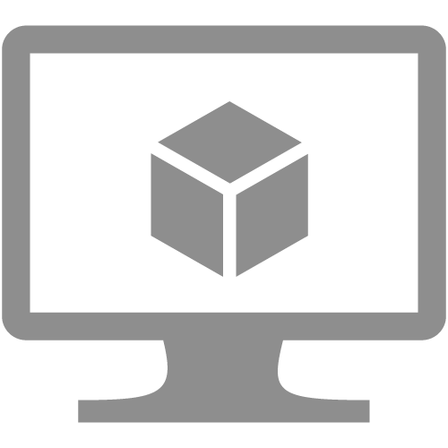


Virtual machines
Cloud services
Web sites

Slide 7
Windows Azure Portal
Demo

Slide 8
Virtual machines
Windows Server and Linux
Flexible Workload Support
Virtual Private Networking
Notes:
Transition:
For the rest of this talk I’m going to give you a tour of Windows Azure, walk you through many of the features, and ground you in the capabilities it provides
The first set of features I want to walk through is Virtual Machines.
Speaking Points:
If you’re familiar with traditional hosting, this is probably the feature that feels most familiar and consistent with what other hosting providers provide.
The ability to stand up a virtual machine with either Windows or Linux that you can basically remote desktop in or SSH in and run any workload.
These virtual machines enable you to be admin on the box
They are durable, meaning if you reboot the VM, it is still there with all of your changes and data you stored to disk
This means you can run any type of workload
If you want to run SQL you can, if you want to install a no-SQL solution, you can do that to.
If you want to run SharePoint you can do that.
Provides ultimate flexibility to do what you want to do
Also enables you to do what we call virtual private networking
With virtual private networking, you can deploy Virtual Machines in the cloud and group them together so they are part of their own private network
You can also then connect it back to your corporate network (if you have one) and establish a VPN secure tunnel to link your machines running in your own corporate environment up to your virtual machines in the cloud – making them look like they’re all part of one connected network.
So lots of flexibility in the compute side as well as in the networking side.

Slide 9
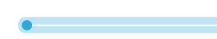



VM with persistent drive
VM with persistent drive
Windows Azure Storage
Notes:
Speaking Points:
The second thing that I want to help you understand…
neat thing that we’re doing with Windows Azure now is making it possible for you to mount durable drives to your virtual machine.
We’re trying to do it in way that it is very reliable, consistent, and delivers a high performance.
One of the things that’s different about how we enabled it is that when you mount a drive either in the portal or in the command line we are backing the disk with the Windows Azure Storage system that we’re running in the cloud today
There are a couple nice characteristics about the storage system.
Replication
One is that we triple replicate the content within the data center.
If a disk ever goes bad that you data is on then we have two other copies of the data that we can work with and we do not have any interruption of service
We can then spin up a new replica once we detect a disk is bad
From your VMs perspective you never know that an issue actually occurred
[Transit to next slide]
So you get much more reliability and an always on experience even when hardware fails
One of the things that we provide which is a little different with Windows Azure is a really powerful storage architecture
When we booted up our Virtual Machine and you saw all of the disks attached to it, the disks were not actually disks. They were virtual disks on top of our Windows Azure Storage system.
We have redundancy built in for you.
We can also load balance our reads and writes to the drives, so we can provide more predictable performance.
On top of these physical drives that we use for blob storage we also have a set of SSD cache of drives. The benefit is that you are reading and writing through an SSD drive and then back to the physical disk.

Slide 10

VM with persistent drive
VM with persistent drive
Windows Azure Storage

Slide 11

VM with persistent drive
VM with persistent drive
Windows Azure Storage

Slide 12
VM with persistent drive
Reliable and always on
Windows Azure Storage
Notes:
Speaking Points:
This is designed to give you very reliable performance and hopefully it ensures that it is always on

Slide 13
WEST
DC
EAST
DC
> 500 miles
Continuous storage geo-replication
Windows Azure Storage
Notes:
Speaking Points:
The third aspect of Windows Azure Virtual Machines that is important to understand is ….
Another thing that is nice about the Windows Azure Storage solution is that we have support for Continuous storage geo-replication
What this means is that whenever you save something in the storage system, in the background we can automatically replicate the data to another datacenter
We guarantee that these data centers are several hundred miles (500) apart so that in the case of a natural disaster or a complete data center failure you can be ensured that a copy of your data exists somewhere else.
You don’t have to set anything up to enable it. It’s automatically enabled by default.
You can turn it off if there are policy reasons why you wouldn’t want it enabled.
The end result is that you can deliver more robust solutions with even greater integrity

Slide 14
Web sites
Build with ASP.NET, Node.js or PHP
Deploy in seconds with FTP, Git or TFS
Start for free, scale up as your traffic grows
Notes:
Speaking Points:
Transition
Virtual machines provide a very flexible compute model.
Another compute service available in Windows Azure is called Windows Azure Web Sites.
Definition:
Windows Azure Web Sites there is a managed service that you can use to run web sites and web APIs.
Enable you to quickly stand up web applications and web sites on the internet
Auto-managed environment
Just say that you want a web, here’s the DNS, copy the content, and we do the rest
You don’t have to worry or think about VMs, servers, or infrastructure.
You can simply focus on building and deploying HTTP based applications.
Enables you to build web sites using ASP.NET, Node.js, PHP, and now with an update a few weeks ago – Python
Allows you to use any tool and any operating system to build these sites including Windows, OS X, and Linux.
Enables a very fast deployment model. You can literally deploy in seconds.
You can easily deploy these sites using the tools and infrastructure you know.
We support several flexible deployment options including FTP, GIT, and Team Foundation Services
What is nice about this offering is that not only does it enable to very quickly get going, but it also allows you to start with a free offer in a shared environment.
Pricing starts at free.. Perpetually free and then you can scale up as you need more capability
You can then scale up these sites using reserved instances for higher performance and isolation and scale out these sites as your web site becomes successful and you have increased load.

Slide 15
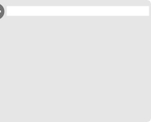
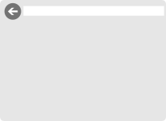

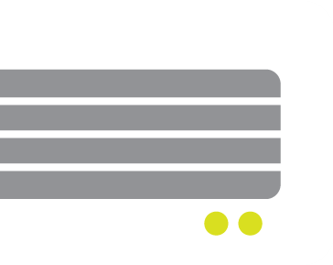
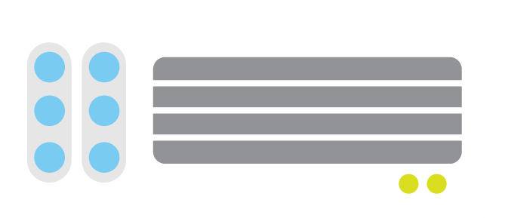
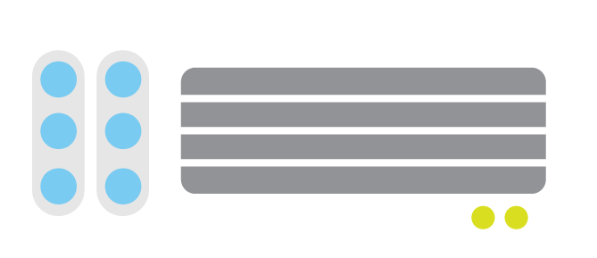
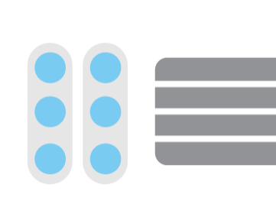
Web sites
shared
reserved
2
shared
Shared instanceS
:-)
:-)
Notes:
Speaking Points:
In shared mode the web sites can be scaled out to run on multiple shared instances,
In this case Windows Azure provides load balancing of incoming requests resulting in better response time and performance for your application and higher availability

Slide 16

Web sites
shared
reserved
1
0
reserved
Shared instanceS
RESERVED instance
:-)
:-)
:-)
Notes:
Speaking Points:
If we really need to scale our application or we want to isolate our application, perhaps to use more memory, we can switch our app to reserved mode
In this case Windows Azure will use an instance out of the pool of available instances, deploy your site, and continue to serve up requests

Slide 17
Web sites
shared
reserved
2
reserved
RESERVED instance
RESERVED instance
:-)
:-)
Notes:
Speaking Points:
Just like with shared mode, we can also scale out with reserved mode, in which case the machine instances are registered with the load balancer for your web application.
This can result in better response time, performance, and availability for your web application.

Slide 18
Cloud services
Build infinitely scalable apps and services
Support rich multi-tier architectures
Automated application management
Notes:
Speaking Points:
We’ve talked about Virtual Machines and we’ve talked about Web Sites, now let’s talk about Cloud Services
Cloud Services is another model we support for building applications.
Cloud Services enable a broader set of workloads then Windows Azure Web Sites, while providing more automated management then Windows Azure Virtual Machines.
Enables you to build what we sometimes refer to as infinitely scalable applications. They can support 1 to hundreds or thousands of course
Support not only web based deployments, but also multi-tier architectures where you might have a combination of front ends, middle tiers, as well as virtual machines running as part of your solution.
Supports automated application management, so it is really easy to deploy, scale out, isolate, and recover from any type of hardware failure. As well as support for automated updates.

Slide 19
What is a Cloud Service?
A container of related service roles
Web Role
Worker Role
Notes:
Note: VM is separated out as IaaS offering.

Slide 20










Application building blocks
Big data
Database
Storage
Traffic
Caching
Messaging
Identity
Media
CDN
Networking
Notes:
Speaking Points:
In addition to the compute services for running your deploying and running your code, Windows Azure also provides a number of application building blocks.
These are managed services that we run that provide a lot of value so you can avoid standing up the infrastructure for common capabilities
You always can stand up VMs and put anything you want in it
But in a lot of cases you will find that we have built in services that we deliver or that are delivered by our partners
What’s cool is that you can use any of these services with a VM, with a Web Site, or with a Cloud Service – so you have flexibility in how you will consume them.

Slide 21
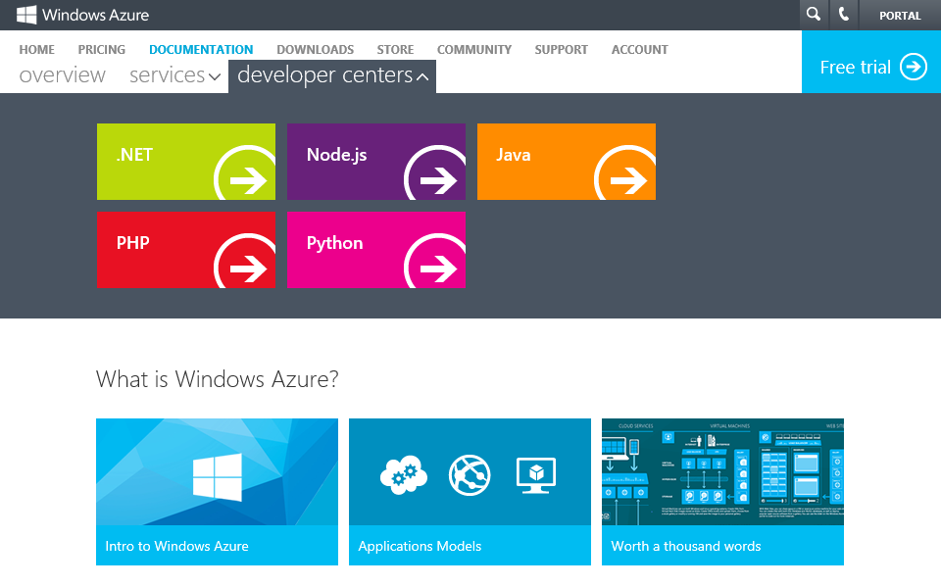
Multiple languages
→ http://WindowsAzure.com
Notes:
Speaking Points:
All of these services can also be used from multiple languages
We now have as part of our developer center on WindowsAzure.com support for multiple different languages including .NET, Node, Java, and PHP.
One of the new languages that we’re now enabling is Python with a complete SDK and dev center.
For each of these we provide libraries that you can consume that call into the REST APIs that we expose for the building block services.
You can also call the REST APIs directly

Slide 22
What Can It Run?
General Rule
If it runs in Windows it runs in Windows Azure
Choice of Language
C#, VB, C++, Java, PHP, Node.js, Python, Ruby etc.
Choice of Frameworks
.NET, ExpressJS, Rails, Zend, etc.

Slide 23
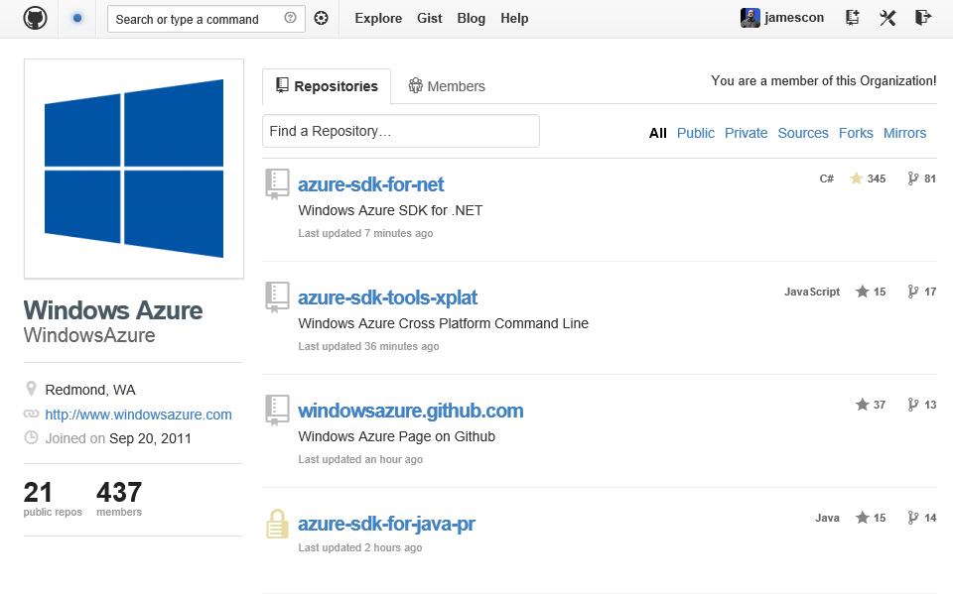
Open source
→ http://github.com/windowsazure
Notes:
Speaking Points:
All of the libraries are hosted on GitHub under an Apache 2 license
So you can both see the source and contribute back to the source

Slide 24
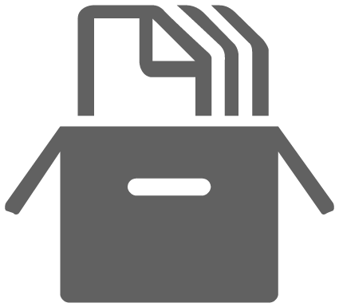
Blob storage
Highly available, scalable and secure file system
Blobs can be exposed publically over http
Continuous geo-replication across datacenters
Notes:
Speaking Points:
We have a great storage system.
We talked about this earlier as part of virtual machines for mounting drives.
You can think of blob storage as a highly available, scalable, and secure file system in the cloud.
You can store any type of data you want in it.
You can optionally expose storage through some HTTP URLs and make it public or you can make it private.
Similar to databases, you can stand up a new storage account in a few minutes.
Continuous geo-replication is enabled by default for storage accounts.

Slide 25

Service bus
Secure messaging and relay capabilities
Easily build hybrid apps
Enable loosely coupled solutions
Notes:
Speaking Points:
We also have a bunch of new service bus capabilities
The Service Bus is a managed service that provides secure messaging and relay capabilities.
It’s great for integrating cloud based solutions with on-premise environments in a very secure way
and it enables a very loosely coupled architecture
With the new Windows Azure SDK and Tools for Visual Studio, you can now view information about the service bus directly from within Visual Studio.
We are also now introducing cross platform libraries so you can use service bus from any OS whether it’s a VM, web site, or Cloud Service and with any of the languages we support.

Slide 26


Windows Azure Scenarios
Ideal for Applications Needing:
Scalability
Availability
Fault Tolerance
Common Application Uses:
Web Sites
Compute Intensive apps
Data Intensive apps
Device Applications
Notes:
VM: A Work environment in the Cloud
Manual workstation burst, R Matlab
VM as a Testing Environment
Blog Storage: Store and share your Data in the Cloud
Use persistent queue and table to scale embarrassingly parallel workload
Publish Reproducible Simulations in the Cloud

Slide 27
VM: A Work environment in the Cloud
Manual workstation burst, R Matlab
VM as a Testing Environment
Blog Storage: Store and share your Data in the Cloud
Use persistent queue and table to scale embarrassingly parallel workload
Publish Reproducible Simulations in the Cloud

Slide 28
Australia
Austria
Belgium
Brazil
Canada
Chile
Colombia
Costa Rica
Cyprus
Czech Republic
Denmark
Finland
France
Germany
Greece
Hong Kong
Hungary
India
Ireland
Israel
Italy
Japan
Korea
Luxembourg
Malaysia
Mexico
Netherlands
New Zealand
Norway
Peru
Philippines
Poland
Portugal
Puerto Rico
Romania
Russia
Singapore
Spain
Sweden
Switzerland
Trinidad & Tobago
UK
United States
New Countries:
Algeria
89
countries and territories
Argentina
Belarus
Bulgaria
Croatia
Dominican Rep
Ecuador
Egypt
El Salvador
Estonia
Guatemala
Iceland
Indonesia
Jordan
Kazakhstan
Kenya
Kuwait
Latvia
Liechtenstein
Lithuania
Macedonia
Malta
Montenegro
Morocco
Azerbaijan
Nigeria
Oman
Pakistan
Panama
Paraguay
Qatar
Saudi Arabia
Serbia
Slovakia
Slovenia
South Africa
Sri Lanka
Taiwan
Thailand
Tunisia
Turkey
UAE
Ukraine
Uruguay
Venezuela
Bahrain
Notes:
Speaking Points:
Windows Azure is commercially available in over 89 countries and territories.
Anyone within these countries can sign up for a free trial or a paid subscription to use Windows Azure services
Of course you can build and deliver solutions to any of your customers worldwide.

Slide 29

Summary
Windows Azure provides a comprehensive set of services that you can selectively compose to build your cloud apps
Global Data Center Footprint
99.95% Monthly SLA. Pay only for what you use.
Flexible & Open Compute Options
Virtual Machines, Web Sites, & Cloud Services
Managed Building Block Services
SQL Database, Cache, Service Bus, & more

